Slide 1
STUDY PROGRESS
IMPORTANT POINTS

Slide 2
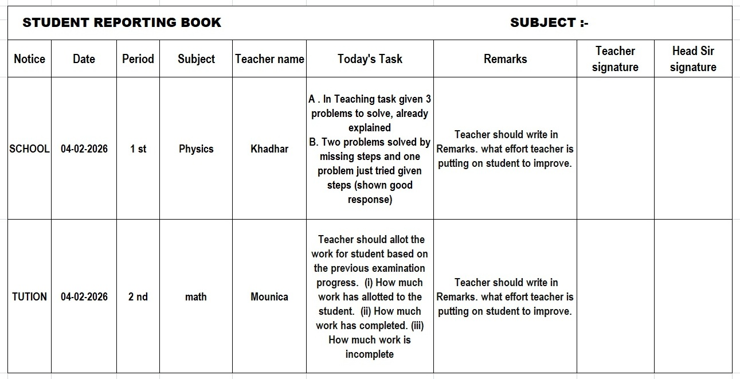

Slide 3
🔑 Strong Classroom Observation & Teaching Responsibility Points for Daily Reporting students
🍀Teachers must observe students continuously,
not assume learning is happening.
🍀Work allotment should be realistic, based on students’ capacity and understanding level.
🍀If students are not studying, it is the teacher’s duty to identify the reason through observation.
🍀Teachers should build confidence in students before expecting performance.
🍀Observation helps teachers understand who is trying and who is struggling.
🍀Even if a student can learn one point clearly, it should be considered progress.

Slide 4
🔑 Strong Classroom Observation & Teaching Responsibility Points for Daily Reporting students
🍀 Teachers must focus on quality of learning, not quantity of content.
🍀 Every student has a different learning capacity—teaching must adapt accordingly.
🍀 Lack of performance should be treated as a signal for guidance, not punishment.
🍀 Don’t compare student with another students.

Slide 5
🍀 Teachers Task
Teacher should write in reporting book what effort teacher is putting on student to improve. And should be observe every minute on duller students.
Teachers should observe the students maintaining books neatly and check their hand writing in books lines should be drawn with pencil neatly.
Some students don't know how to write heading they are starting with small letters.
Teachers observe this one and correct it.
Teacher should allot the work for student based on the previous examination progress. Teacher should note in student reporting book.
(i) How much work has allotted to the student.
(ii) How much work has completed.
(iii) How much work is incomplete
First Teachers should maintain duller students reporting books to improve students.

Slide 6
🍀 Teachers Task
After all your efforts no changes in student progress then add in the Coordinator List.
Coordinator has to follow up the student of which teacher has given complaint.
After Coordinator follow up the student progress has no change then add to Head Sir List.

Slide 7
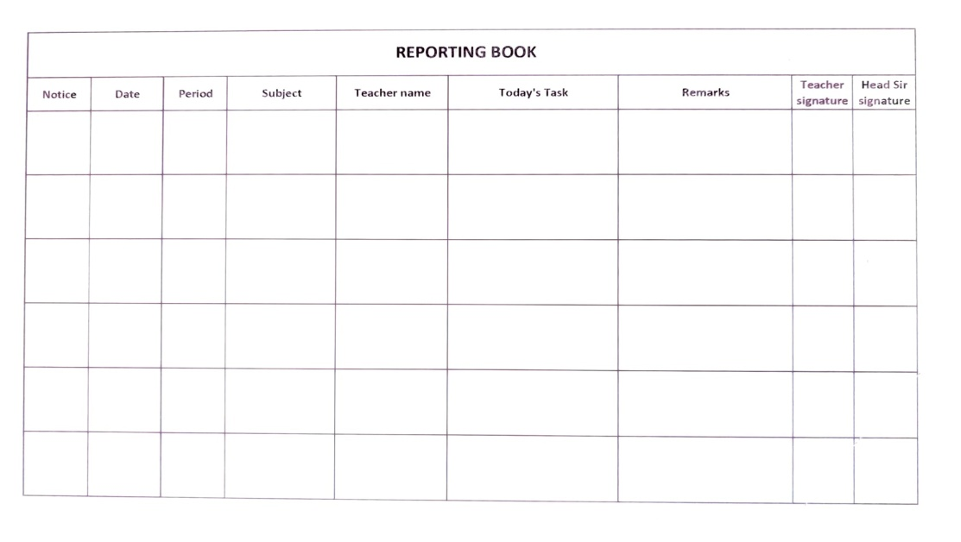
🔑 Strong Classroom Observation & Teaching Responsibility Points for Daily Reporting students .
Teacher Should Monitor the class :-
*Attention Level
*Effort put by Students
*Willingness to try
*Fear or lack of Confidence

Slide 8
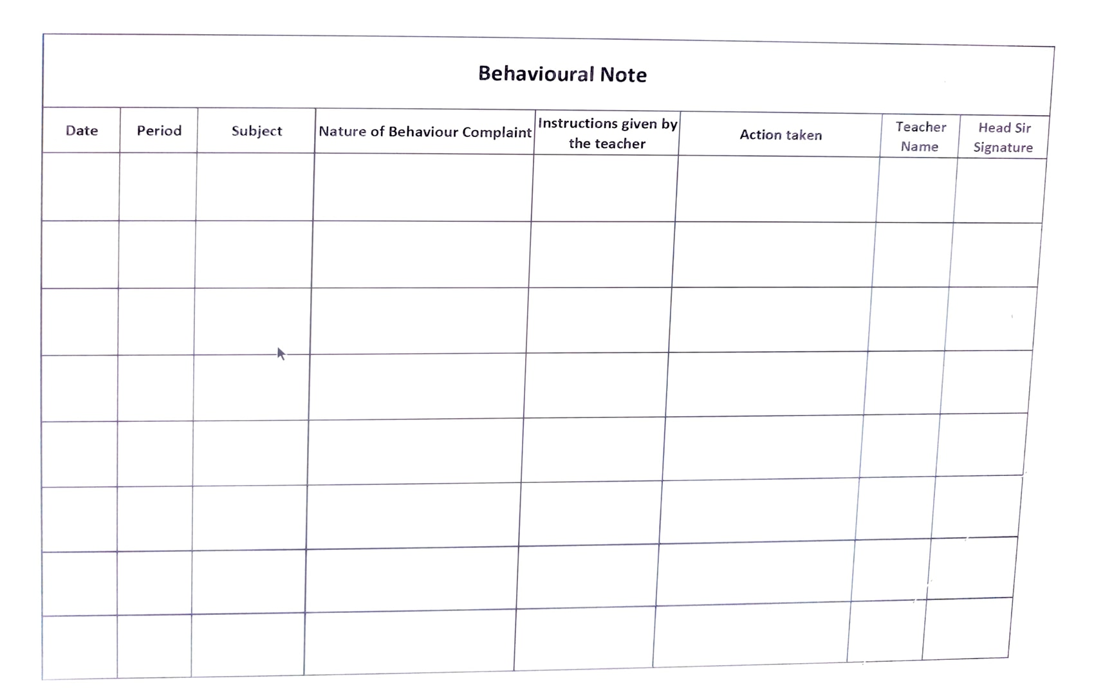

Slide 9
BEHAVIOURAL MONITORING
Individual student behavior issues must be recorded clearly
Teachers should counsel students regularly and note their observation
If no improvement is seen after counseling, the same must be noted in the individual report
Serious or repeated behavior issues should be brought to the notice of the M.D

